Slide 1

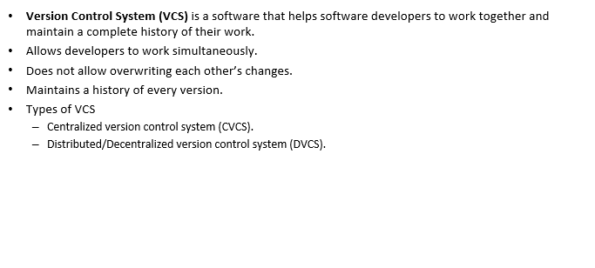
Version Control System

Slide 2
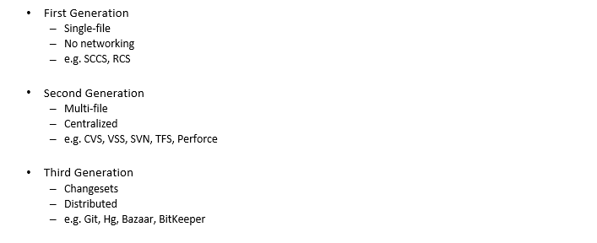
A Brief History of Version Control

Slide 3
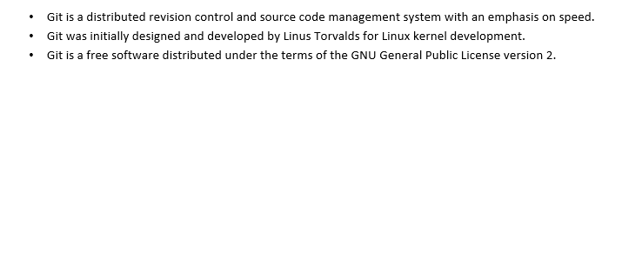
GIT Basic Concepts

Slide 4
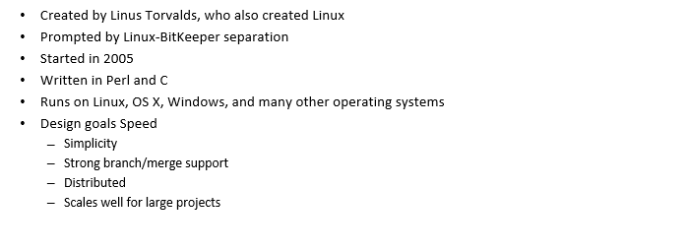
About Git

Slide 5
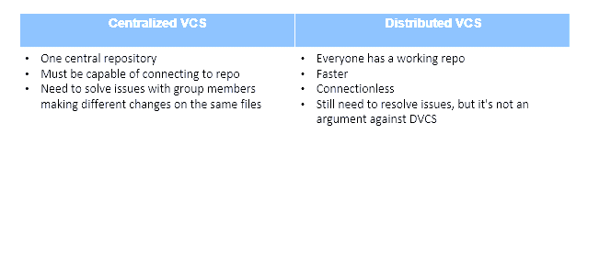
Distributed Version Control System

Slide 6
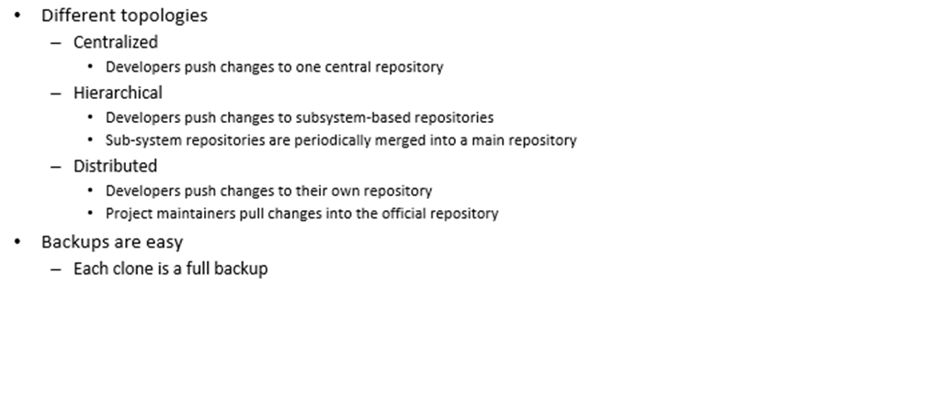
Distributed Version Control System - Advantages

Slide 7
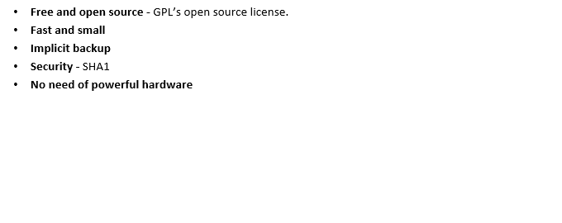
Advantages of Git

Slide 8
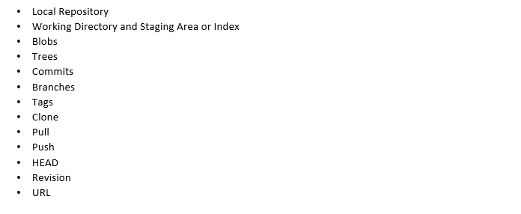
DVCS Terminologies

Slide 9
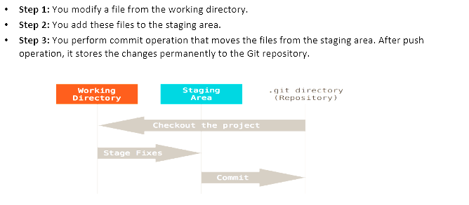
Basic workflow of Git

Slide 10
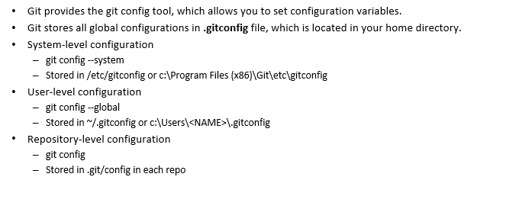
Configuring Git

Slide 11
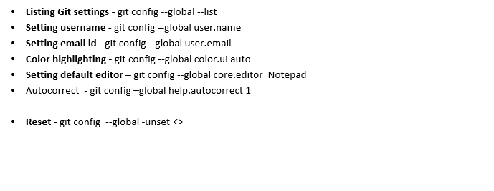
Configuring Git

Slide 12
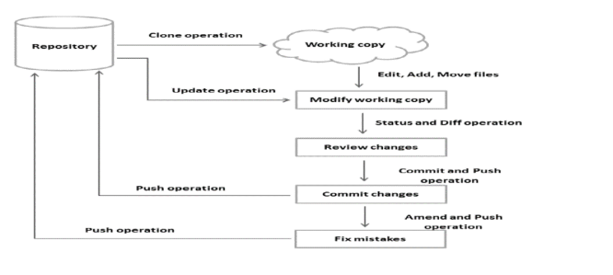
Life Cycle

Slide 13
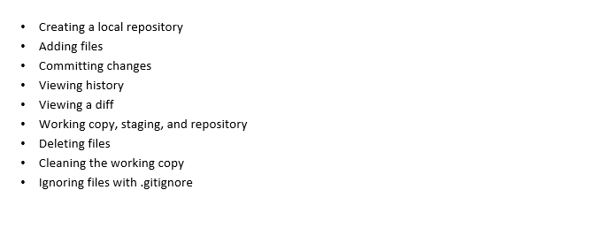
Working Locally With Git

Slide 14
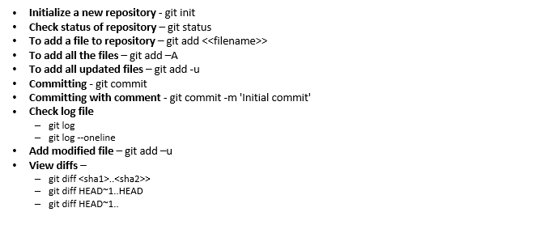
Working Locally With Git

Slide 15
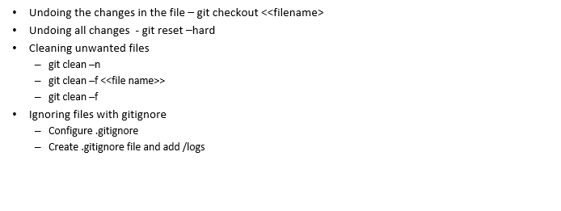
Working Locally With Git

Slide 16
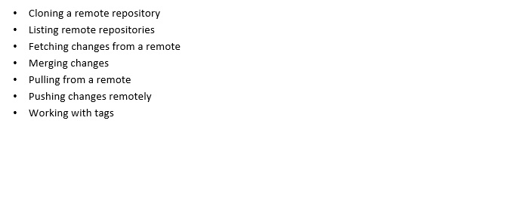
Working Remotely With Git

Slide 17
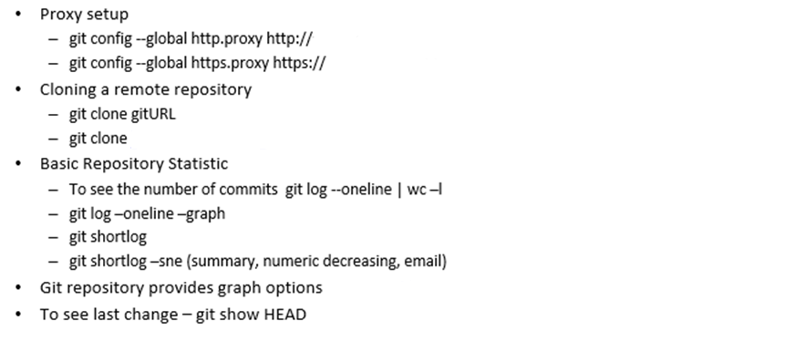
Working Remotely With Git

Slide 18

Working Remotely With Git

Slide 19
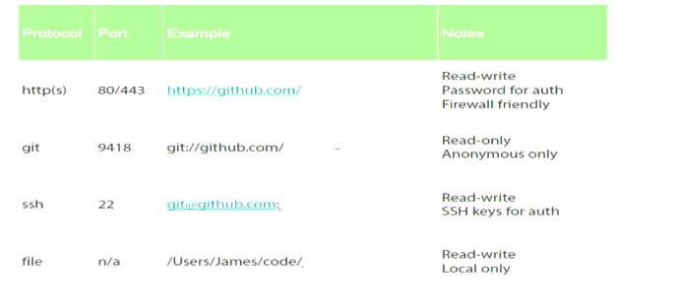
Git Protocols

Slide 20
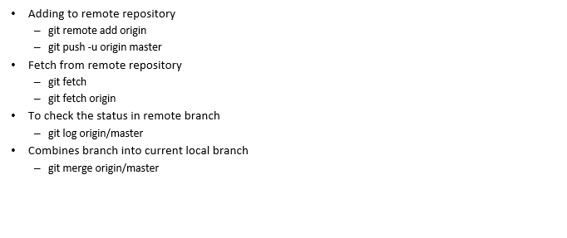
Fetching from a Remote

Slide 21
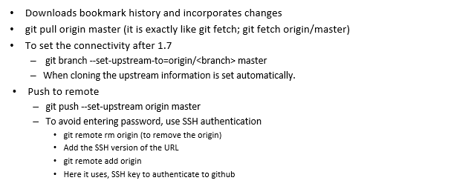
Pulling/Pushing from/to a remote

Slide 22
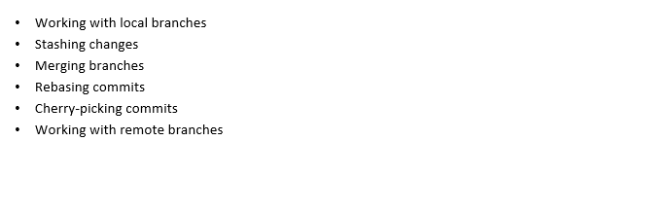
Branching/Merging

Slide 23
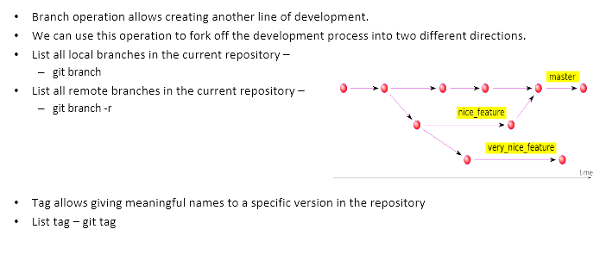
Viewing Branches and Tags

Slide 24
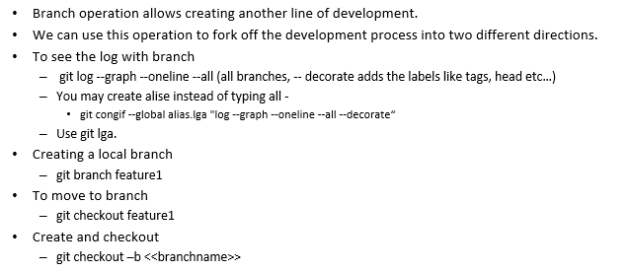
Branching

Slide 25
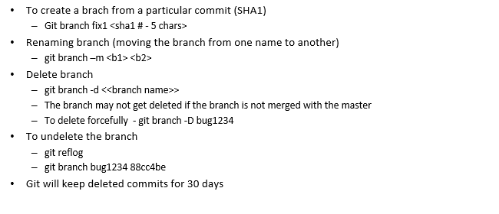
Branching

Slide 26
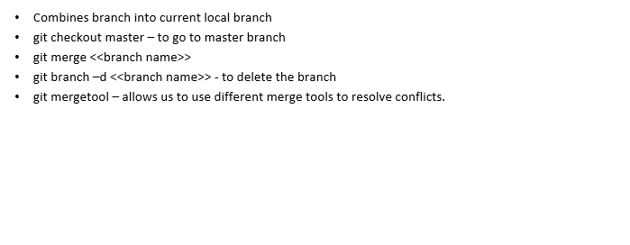
Merging Branches

Slide 27
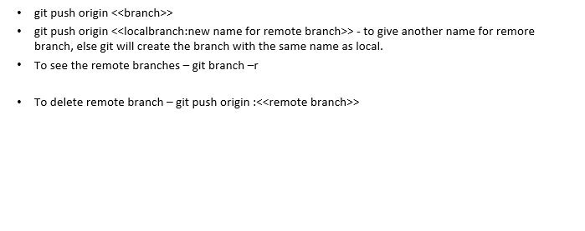
Creating/Deleting a Remote Branch

Slide 28
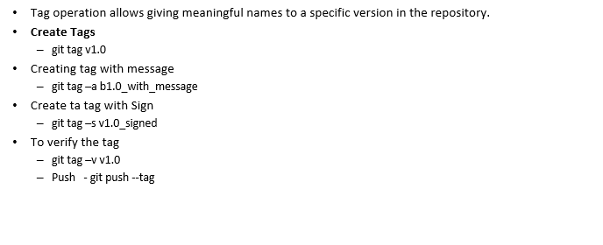
Creating and Verifying Tags

Slide 29
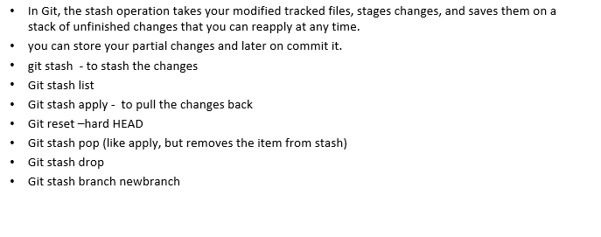
Stashing Changes

Slide 30
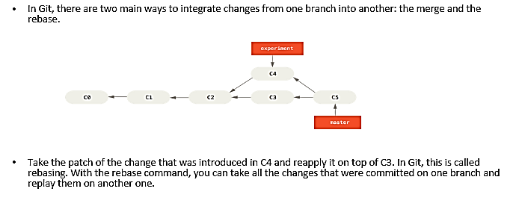
Rebasing Changes

Slide 31
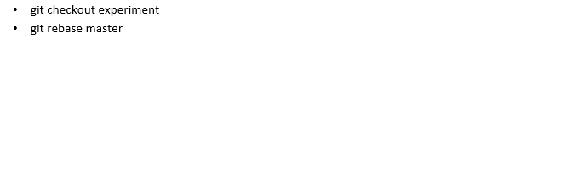
Rebasing Changes

Slide 32
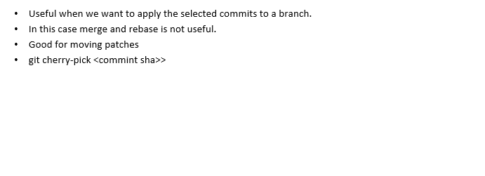
Cherry-Picking

